Slide 1

Austrian Circular Economy Platform
CASE OF SLOVENIA:
Preparing the Circular Economy Roadmap
Ladeja Godina Košir, Founder and Executive Director, Circular Change
Vienna, 21 March 2018

Slide 2

ON THE WAY TO THE NATIONAL CE ROADMAP
Circular Economy - embracing circular transition
Circular Change - platforms as transition enablers
Slovenia – the process of CE Roadmap co-creation
Circular Economy vs. Bioeconomy – linking two concepts
Lessons learned

Slide 3
1. CIRCULAR ECONOMY – EMBRACING CIRCULAR TRANSITION
Topic for NGO‘s and environmentalists
Ministry of the Environment „in charge“ for this issue
We need new jobs and higher salaries – not circular economy
www.circularchange.com #SLOroadmap #circulareconomy #CEstakeholderEU

Slide 4

Austria & Slovenia – Austro-Hungarian roots
„Systemic approach“ implemented under Maria Theresa in the 18th Century
Infrastructure, Economy, Telecommunications
„Smart Specialisation“ – regional action planes
www.circularchange.com #SLOroadmap #circulareconomy #CEstakeholderEU

Slide 5
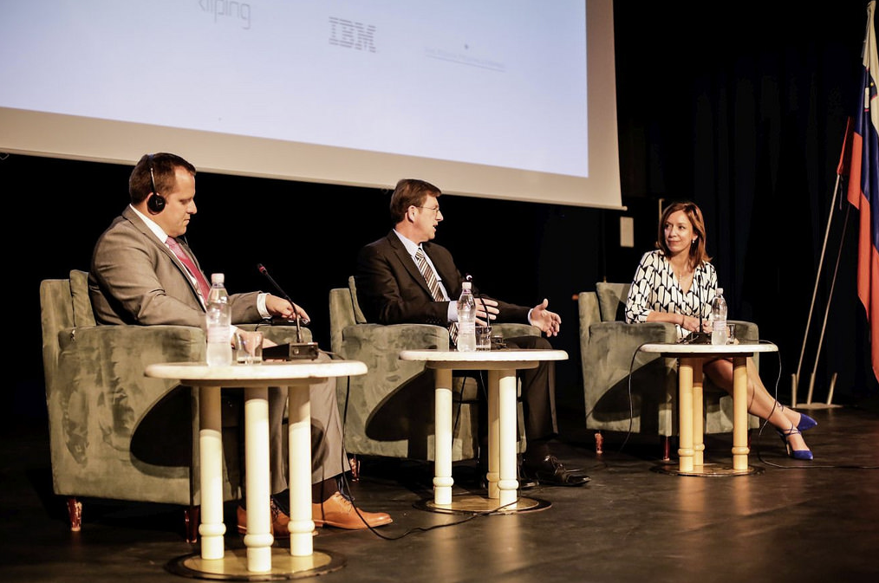
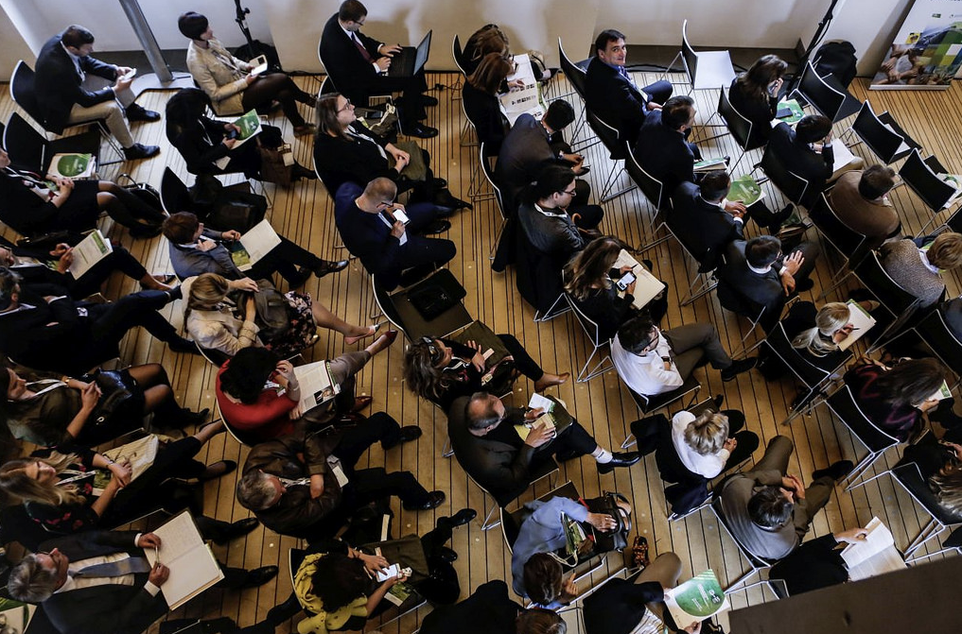
2. CIRCULAR CHANGE - PLATFORMS AS TRANSITION ENABLERS
Innitative 2015, offical lounch at the 1st Circular Change Conference – May 2016
Private non-profit organisation - the first and only Slovenian CE platform
Advisory Board: 5 members, chaired by dr. Janez Potočnik (former EU Comissioner, UNEP IRP, Systemic)
What we do: educate, raise awareness, engage different stakeholders (private and public), connect the dots, talk, moderate, write, consult,… → make Slovenia a “circular playground”
Competence and communication partner for the government
Approach: based on practical solutions, economic benefits of CE
In 2017: 70% increase in CE exposure in media, 40 speaking opportunities, 30 events co-organised, 20 int. partnerships, 15 projects with companies
Flagship: International Circular Change Conference – in 2018 the 3rd edition – 10 and 11 May
www.circularchange.com #SLOroadmap #circulareconomy #CEstakeholderEU

Slide 6
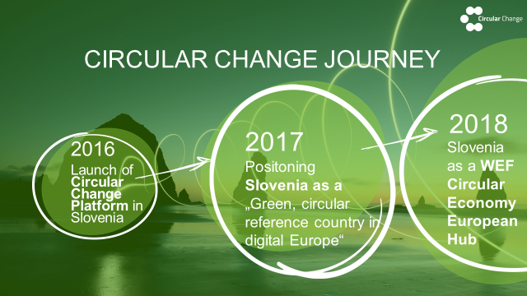
In 3 years from local to global player
www.circularchange.com #SLOroadmap #circulareconomy #CEstakeholderEU

Slide 7
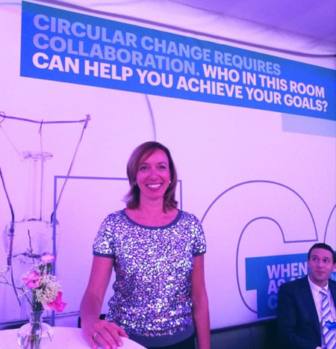
Global Circular Economy Leadership Award – Davos
www.circularchange.com #SLOroadmap #circulareconomy #OECDseeurope

Slide 8
3. SLOVENIA – THE PROCESS OF CE ROADMAP CO-CREATION
Partnership for a green economy: cross-sectoral initiative, led from the office of the PM
National Documents: Vision 2050, Strategy 2030, Smart Specialisation, SLO Member of EMF CE100
Ministry of the Environment as a contractor of the Roadmap project
Circular Change as the integrator of the Roadmap consortium
www.circularchange.com #SLOroadmap #circulareconomy #CEstakeholderEU

Slide 9

Roadmap: Towards the Circular Economy in Slovenia
GOALS:
sLOVEnia as the frontrunner in CE transition in the CEE region
Engaging stakeholders for identifying and connecting best practices
Recommendations for the Slovenian Government for accelerating the circular transition
Increasing the competitiveness of the economy and maintaining a high quality of life for everyone
www.circularchange.com #SLOroadmap #circulareconomy #CEstakeholderEU

Slide 10
www.circularchange.com #SLOroadmap #circulareconomy #CEstakeholderEU

Slide 11
Circular triangle
CIRCULAR ECONOMY
From linear to circular business models
CIRCULAR CHANGE
Holistic & systemic approach
CIRCULAR CULTURE
Rethinking values & narrative
Source: Gm – Circular Change, 2017
www.circularchange.com #SLOroadmap #circulareconomy #CEstakeholerEU

Slide 12
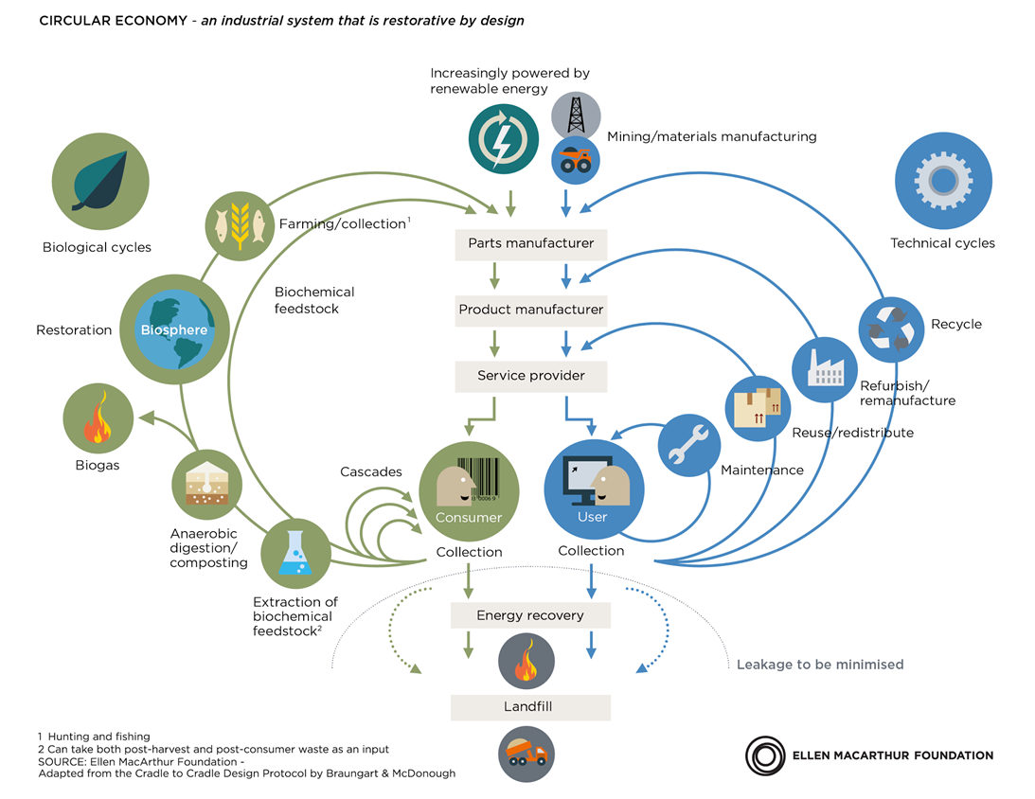

4. CIRCULAR ECONOMY VS. BIOECONOMY - LINKING TWO CONCEPTS
www.circularchange.com #SLOroadmap #circulareconomy #CEstakeholderEU

Slide 13
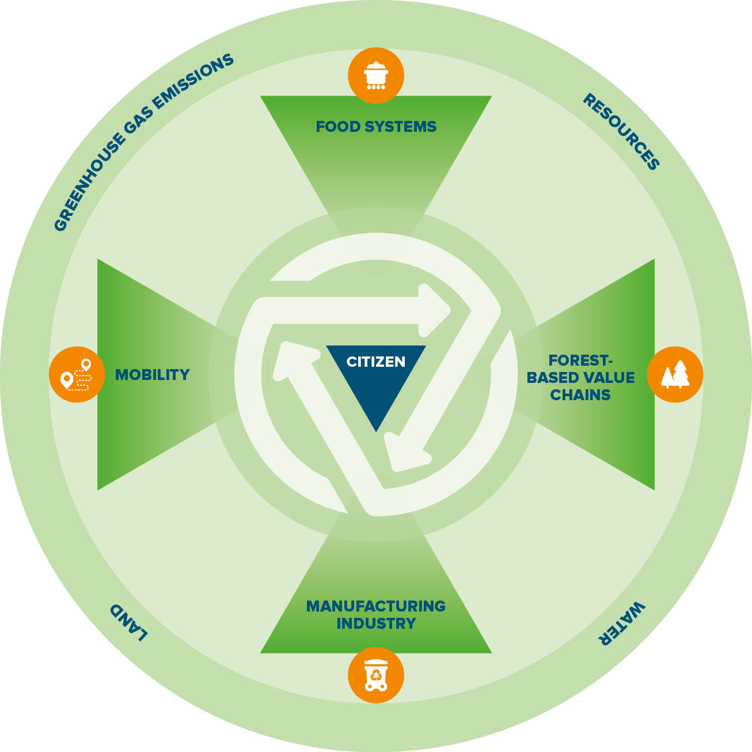
The four priority fields for the circular transformation
4 FIELDS introduced in the Roadmap:
Food systems
Forest-based value chains
Manufacturing industry
Mobility
Highlight best practices in each field and link them to circular business models
www.circularchange.com #SLOroadmap #circulareconomy #CEstakeholderEU

Slide 14
Slovenia: Green reference country in digital Europe
Greenest country in Europe: 35% of the area covered by Natura 2000
→ green” is in our DNA → less politicized topic
Small, homogenous, well-educated population
Good results in communal waste management (58% recycling rate, 2016)
Export-oriented economy: lots of semi-products → hit by the crisis, now modernizing quickly, entrepreneurial activity growing, digitalisation, blockchain technologies
Challenges: 75% dependant on imported resources, companies in global supply chains, low productivity, added value, mostly SMEs with little free funds, lack of coherent national development strategy, lack of cross-sectoral activity in the government
www.circularchange.com #SLOroadmap #circulareconomy #CEstakeholderEU

Slide 15
5. LESSONS LEARNED
CE SHOULD BE PRIORITY OF THE GOVERNMENT (not only ENV): Defined in the strategic documents, supported by indicators, monitoring, reporting and linked to the core economic policy decisions.
ALL POLICIES SHOULD BE SYSTEMATICALLY ADJUSTED: Beyond GDP, natural capital accounting, corporate sustainability reporting, tax policy, state aid, public procurement, product design, use of banking potential, R and D and innovation, investments in infrastructure, education, consumers awareness, new business models, support to SMS, etc.
ACTIVE DIALOGUE WITH ALL STAKEHOLDERS IS NECESSARY: Transition is only possible if we actively involve those loosing in the process of transition – CIRCULAR CULTURE
www.circularchange.com #SLOroadmap #circulareconomy #CEstakehlderEU

Slide 16
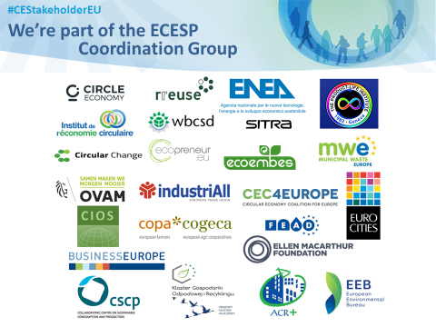
JOIN US!
www.circularchange.com
Info: join@circularchange
MSc Ladeja Godina Košir
E: ladeja@circularchange.com
Twitter: @ladeja68
www.circularchange.com #SLOroadmap #circulareconomy #CEstakehlderEU

